Slide 1
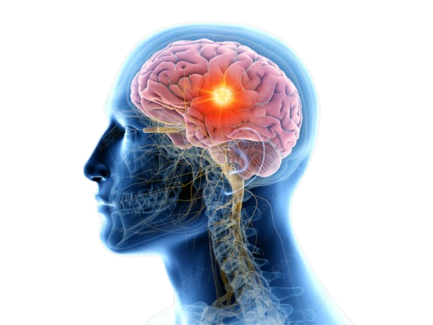
BRAIN TUMOR DETECTION USING DEEP LEARNING
Under the Esteemed Guidance of
Mr.S.Naga Chandra Sekhar
TEAM:C11
Y.Mani Sudheer(Y20ACS589)
P.karunakar(Y20ACS539)
S.S.V.S.Eswar(Y20ACS554)
R.pavan Kumar(Y20ACS544)

Slide 2
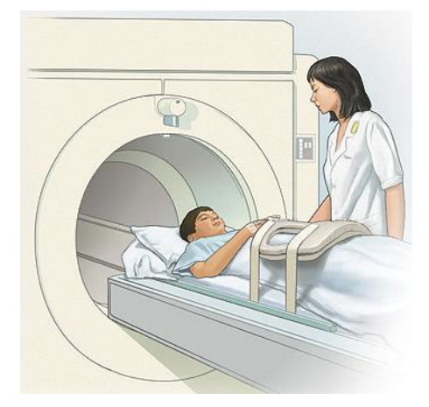
PROJECT FOLDER
"This project was executed methodically with essential components organized within the project folder. This included code for execution, the 'BrainTumorDetection' dataset, and the VGG16 model loaded into the 'model' directory. The trained model, named 'my_model.h5', was saved within the 'saved' folder. Such structuring ensured efficient access to resources, facilitating smooth project execution."

Slide 3
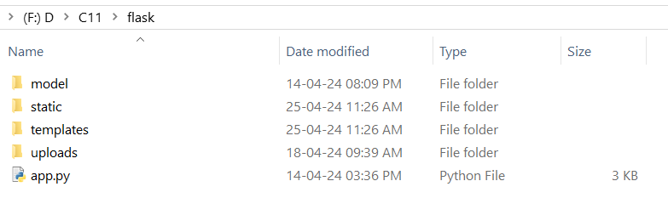
FLASK FOLDER
Navigate to the 'uploads' folder within the Flask directory. This is where images uploaded for testing purposes will be stored directly. Additionally, explore the 'model' directory for the saved model(my_model.h5), the 'static' folder for images, and the 'templates' directory for HTML and CSS pages. Finally, open 'app.py' to view the Flask code for the application.

Slide 4
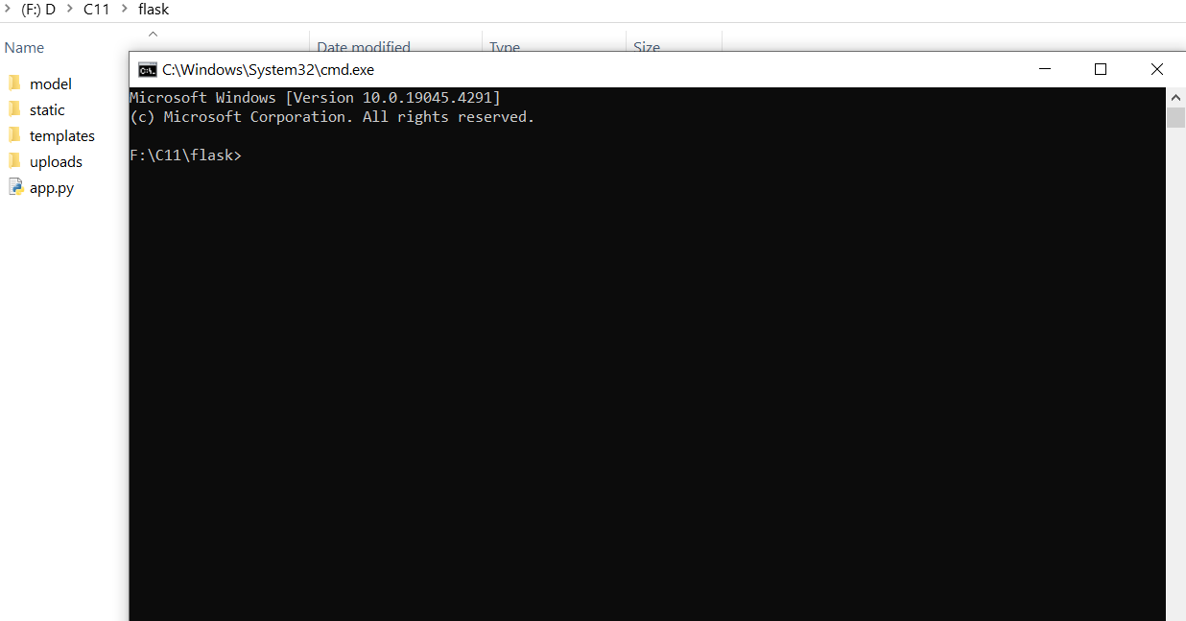
EXECUTION STEPS FOR PROJECT
Step 1:
Navigate to the Flask folder where all the essential components are located, including the 'model', 'uploads', 'app.py', 'static', and 'templates' directories.

Slide 5
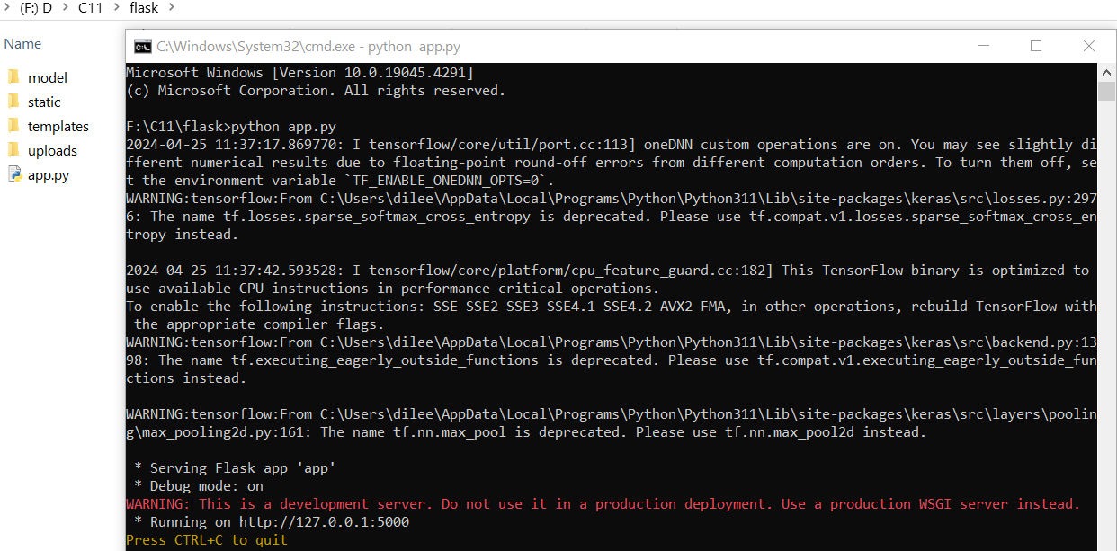
EXECUTION STEPS FOR PROJECT cont..
Step 2:
open Command Prompt in that location and type python app.py to run the Flask application.

Slide 6
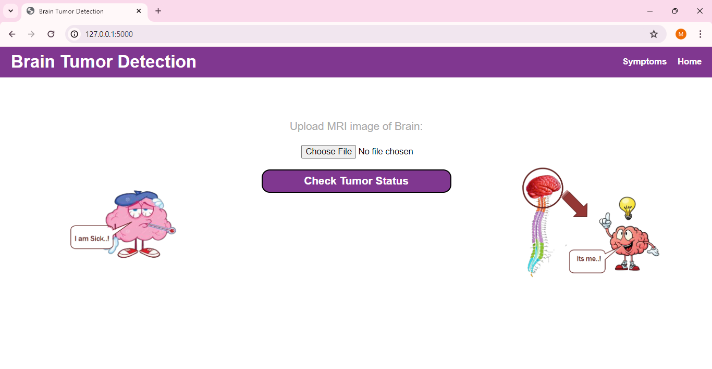
EXECUTION STEPS FOR PROJECT cont..
Step 3:
Copy the link "Running on http://127.0.0.1:5000" displayed in the Command Prompt and paste it into your web browser's address bar. Then, press Enter to access the Flask application running locally on your machine.

Slide 7
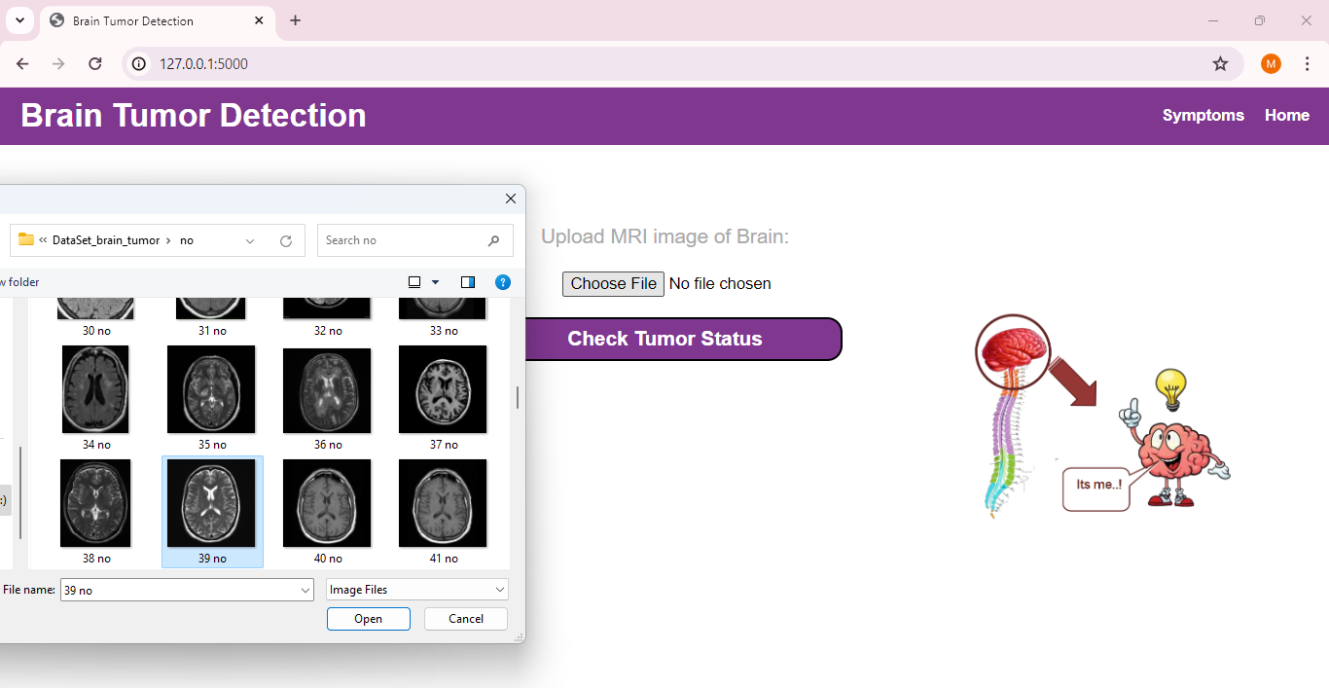
EXECUTION STEPS FOR PROJECT cont..
Step 4:
Browse the brain MRI image and verify the tumor status.

Slide 8
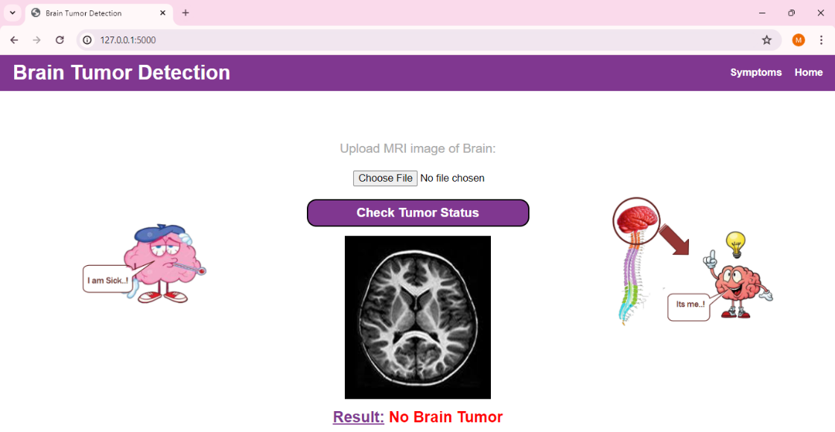
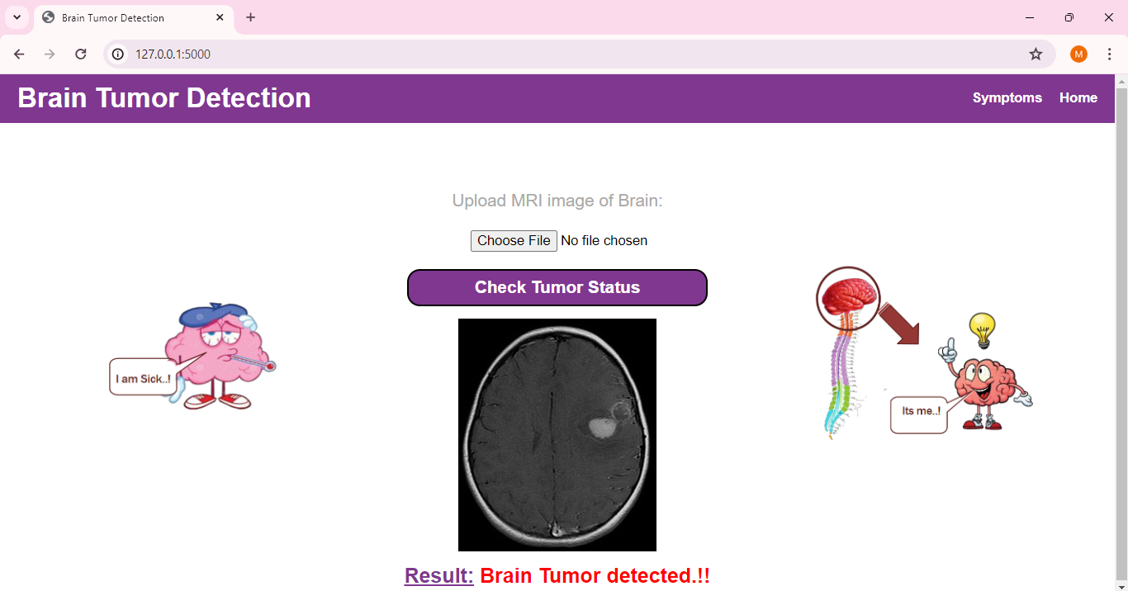
OUTPUT

Slide 9
THANK YOU...!!

